Slide 1
EP2150 - Entrepreneurship
Chapter 1 – Foundations of Entrepreneurship
Fall 2016
Peter Robertson

Slide 2


Slide 3
Learning Objectives For Today
Define the role of the entrepreneur in.
Describe the entrepreneurial profile and evaluate your potential as an entrepreneur.
Describe the benefits and drawbacks of entrepreneurship.
Explain the forces that are driving the growth in entrepreneurship.
Explain the cultural diversity of entrepreneurship.
Describe the important role small business plays in a nation’s economy.
Put failure into the proper perspective.
Explain how entrepreneurs can avoid becoming another failure statistic.

Slide 4
The World of the Entrepreneur
Every year U.S. entrepreneurs launch 565,000 new businesses.
  Most of those will fail!
Entrepreneurial Spirit
  Is the most significant economic development in recent history.
  GEM study: 12.3% of adult population in the U.S. is actively involved in trying to start a new business.

Slide 5
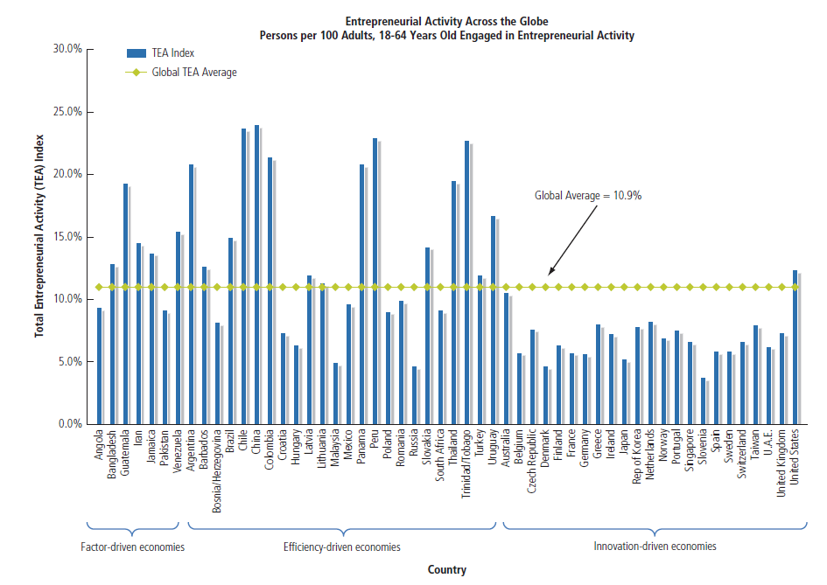
Entrepreneurial Activity Across the Globe

Slide 6
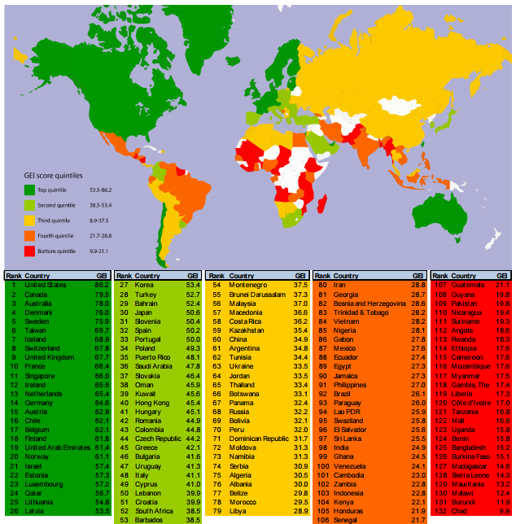
https://thegedi.org/countries

Slide 7
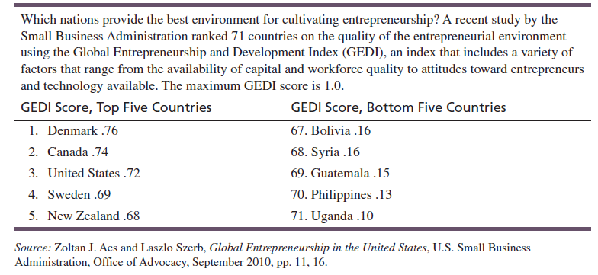
Entrepreneurship-Friendly Nations

Slide 8
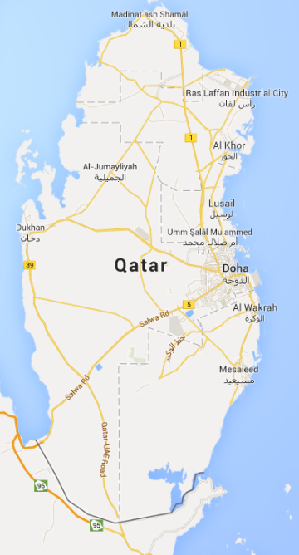
Entrepreneurship in Qatar
Entrepreneurship and the 2030 Vision:
  From Carbon based to Knowledge based
  20,000+ SME’s
  Enterprise Qatar - 100m QR Investment Fund
  Q Business Incubator Center – QDB & SDC
  Establish an Entrepreneurial Eco-System.

Slide 9
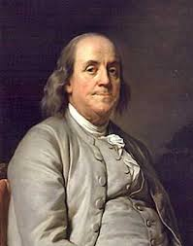
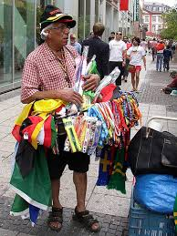

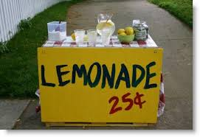
What is an Entrepreneur?
One who creates a new business…
in the face of risk and uncertainty…
for the purpose of achieving profit and
growth…
by identifying opportunities,
and assembling the necessary resources to capitalize on them.

Slide 10
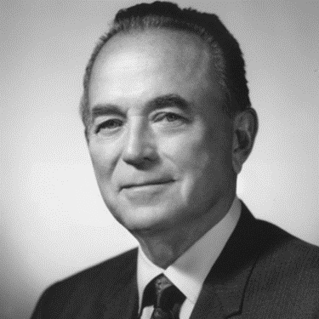
Characteristics of Entrepreneurs
Desire for responsibility
Preference for moderate levels
of risk – risk eliminators
Confidence in their ability to
succeed
Desire for immediate feedback
High level of energy
Future orientation – opportunity, necessity, and serial entrepreneurs
Skilled at organizing
Ray Kroc (1902 -1984)
McDonald’s

Slide 11
Characteristics of Entrepreneurs
Entrepreneurs tend to have:
  A high degree of commitment
  Tolerance for uncertainty
  Flexibility
  A willingness to work hard
  Determination
YouTube Video:
25 Common Characteristics of
Successful Entrepreneurs
15 Characteristics of Entrepreneurs
https://www.youtube.com/watch?v=sOjeQV5pHh4#t=94.2174401

Slide 12
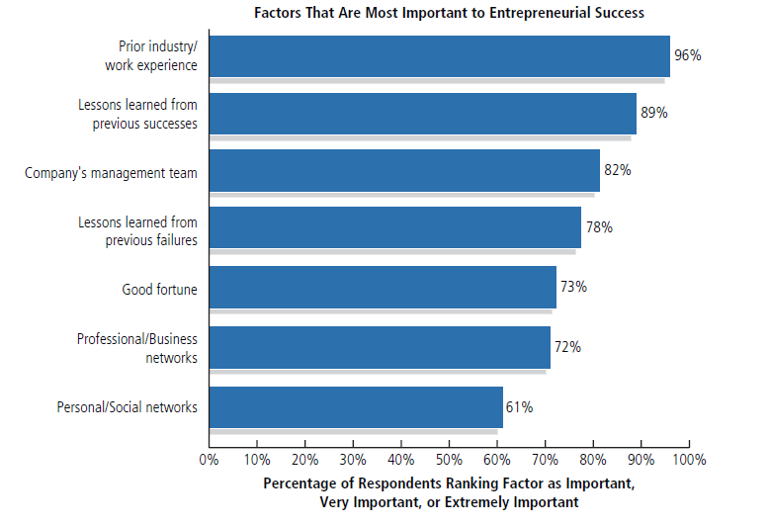
Sources of Entrepreneurial Success

Slide 13

Benefits of Entrepreneurship
The opportunity to:
Create your own destiny
Make a difference
Reach your full potential
Reap impressive profits
Contribute to society and to
be recognized for your efforts
Do what you enjoy and to have fun at it

Slide 14

Drawbacks of Entrepreneurship
Uncertainty of income
Risk of losing your entire investment
Long hours and hard work
Lower quality of life until the business gets established
High levels of stress
Complete responsibility
Discouragement

Slide 15

Feeding the Entrepreneurial Fire?
Entrepreneurs as heroes
Entrepreneurial education
Demographic and economic factors
Shift to a service economy
Technology advancements Independent lifestyles
The Internet and cloud computing
International opportunities

Slide 16
Entrepreneurship
Who can be an Entrepreneur?
Anyone – regardless of age, race, gender, color, national origin, or any other characteristic – can become an entrepreneur…
(although not everyone should).
Stuff Entrepreneurs Say
Richard Branson - Advice for Entrepreneurs

Slide 17

The Cultural Diversity of Entrepreneurship
Young entrepreneurs
Women entrepreneurs
Minority-owned enterprises
Expatriate [Immigrant] entrepreneurs
Part-time entrepreneurs
Home-based businesses
Family businesses
Copreneurs
Corporate castoffs
Corporate dropouts

Slide 18
Small Businesses ...
28 million businesses in U.S. – 99.7% SMALL
Employ 50% U.S. private sector workforce.
Create more jobs than BIG businesses.
  65% of net new jobs over the last decade
3% SMALL companies create 70% of net new jobs in the economy.
90% SMALL have fewer than 20 employees.
Produce 46% U.S. GDP.

Slide 19
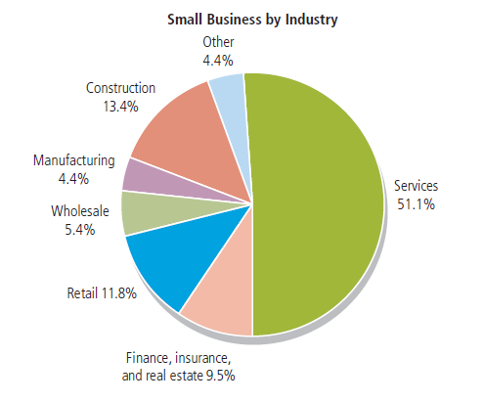
Small Businesses by Industry

Slide 20
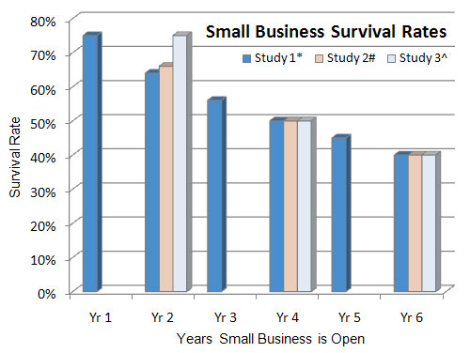
Small Business Failure Rates
Failure Rate*
Y1 25 %
Y2 36 %
Y3 44 %
Y4 50 %
Y5 55 %
Y6 60 %
Y7 63 %
Y8 66 %
Y9 69 %
Y10 71 %
http://www.statisticbrain.com/startup-failure-by-industry/Research Date: 1.1.2014
* Headd, B. Redefining Business Success: Distinguishing Between Closure and Failure, 2002 # Shane, S. Startup Failure Rates – The Real Numbers, 2008 Phillips & Kirchhoff. Small Business: Critical Perspectives 1989

Slide 21
Ten Deadly Mistakes of Entrepreneurship
Management mistakes
Lack of experience
Poor financial control
Weak marketing efforts
Failure to develop a strategic plan
Uncontrolled growth
Poor location
Improper inventory control
Incorrect pricing
Inability to make the “entrepreneurial transition”

Slide 22
Putting Failure Into Perspective
Entrepreneurs are not paralyzed by the prospect of failure.
Failure – a natural part of the creative process.
Successful entrepreneurs learn to fail intelligently.

Slide 23

Avoiding the Pitfalls of Small Business Failure
Know your business in depth
Develop a solid business plan
Manage financial resources
Understand financial statements
Learn to manage people effectively
Set your business apart from the competition
Maintain a positive attitude

Slide 24
Recap
  What is an Entrepreneur?
  What are the Benefits & Drawbacks of Entrepreneurship?
  What is feeding the Entrepreneurial fire?
  Cultural diversity of Entrepreneurship.
  Avoiding the pitfalls of Small Business failure.
Ch. 1: The Foundations of Entrepreneurship

Slide 25
Suggested Readings
Entrepreneur? Characteristics of… p20-24
Entrepreneurship, Benefits/ Drawbacks… p25-29
Feeding the Entrepreneurial fire… p30-32
Groups leading development of Entrepreneurship… p34-40
Pitfalls of business failure… p45-47

