Slide 1
ISW Lesson 3
Steve Jobs AND ……….. ………..TASK METHOD VS PEOPLE METHOD…… Leadership……VS MANAGEMENT

Slide 2
Introduction
Introduction to Steve Jobs
TASK METHOD VS PEOPLE METHOD
DISCUSSION ON Leadership VS MANAGEMENT
Group activities
summary
Powerpoint
VIDEO
Activities
You will learn about Steve Jobs. There will also be an activity where you make the case for Steve Jobs – based on the discussion of Task vs People Method with a discussion of Leader vs Manager……………………….Each team will contribute 3 examples in each area based on the information provided. Success will be evidenced by group activity, discussion and hands on learning – we will watch a video https://www.youtube.com/watch?v=K-Yv-UdsmSo

Slide 3
A BRIEF BIO
Steven Paul "Steve" Jobs; February 24, 1955 – October 5, 2011)
American information technology entrepreneur and inventor. He was the co-founder, chairman, and chief executive officer (CEO) of Apple Inc.;
CEO and largest shareholder of Pixar Animation Studios;[3]
a member of The Walt Disney Company's board of directors following its acquisition of Pixar; and founder, chairman, and CEO of NeXT Inc.
Jobs is widely recognized as a pioneer of the microcomputer revolution of the 1970s, along with Apple co-founder Steve Wozniak. Shortly after his death, Jobs's official biographer, Walter Isaacson, described him as a
"creative entrepreneur whose passion for perfection and ferocious drive revolutionized six industries: personal computers, animated movies, music, phones, tablet computing, and digital publishing."[2]
BIOGRAPHY BIO OF STEVE JOBS

Slide 4
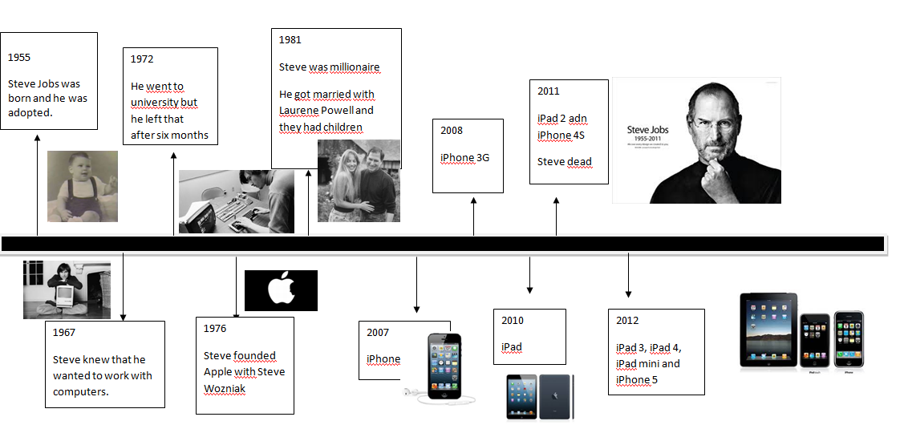
I Boat
At 2:26

Slide 5
ACTIVITY use video, case, YOUR PERSONAL KNOWLEDGE and a brief biography - TO LIST 3 EXAMPLES OF EACH
Question – DISCUSSION……TIME WILL BE A CHALLENGE
TEAM 1 – The IMACS
TASK - STEVE JOBS WAS A TASK METHOD LEADER BECAUSE…….
1. 2. 3.
TEAM 2 – The IPADS
TASK - PEOPLE METHOD LEADER BECAUSE………….
1. 2. 3.

Slide 6


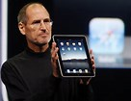
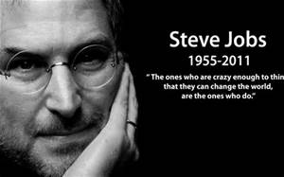
STEVE JOBS
IN VIDEO
IN WORDS – brief bio, Case Handout

Slide 7
Leadership
The ability to influence people and to reach goals
Leadership takes energy
Leadership is about “people” - not task information or problems.
Leadership uses power

Slide 8
Leadership
…. Is a process of creating vision, inspiring commitment and directing people to a common goal……
… Great leaders get extra ordinary things done in organization……
Leaders and managers may not be the same thing…..

Slide 9
Leader versus Manager
Management Power:
Comes from the organizational structure – from a position.
Promotes stability, order and problem solving within the structure, within the rules.
Leadership Power:
Comes from the person - from personal interests, goals, and values.
Promotes vision, creativity, and change – new ways.

Slide 10
LEADER OR MANAGER or manager or leader - WHICH IS WHICH??
MANAGER
LEADER
Position power
Structured
Problem solver
Authoritative
Stabilizing
Rational
Vision
Passion
Flexibility
Imaginative
Innovative
Experimental

Slide 11
Task Method Leaders
        set rules
      meets deadlines
      shows how to improve performance
      becomes more efficient
Best for:
          big projects
        mechanical work
      highly integrated work environments

Slide 12
People Method Leaders
    praises and rewards
    listens
    informs
    builds teams
    allows employees chance to do it their way
Best for:
most companies and situations
where motivation and commitment are required by staff
where creativity is valuable

Slide 13
Leadership Styles
Leadership styles result from
different combinations of concerns
for task and people

Slide 14
ACTIVITY use video, case and a brief biography
TO LIST 3 EXAMPLES OF EACH
TEAM 1 – THE IMACS
TASK - STEVE JOBS WAS A TASK METHOD LEADER BECAUSE…….
2. 3.
TEAM 2 – THE IPADS
TASK - PEOPLE METHOD LEADER BECAUSE………….
2. 3.

Slide 15
SUMMARY
Introduction to STEVE JOBS
TASK vs People Method
Activity – Team 1 and Team 2 and Results…………
Summary

Slide 16
THE Imacs
TEAM 1

Slide 17
ipads
Team 2

Slide 18
