Slide 1
Cultural Dynamics in Assessing Global Markets
Chapter 4

Slide 2
Learning Objectives
LO1 The importance of culture to an international marketer
LO2 The origins of culture
LO3 The elements of culture
LO4 The impact of cultural borrowing
LO5 The strategy of planned change and its
consequences

Slide 3
Culture’s Pervasive Impact
Culture influences every part of our lives
Cultures impact on birth rates
  Birthrates have implications for sellers of diapers, toys, schools, and colleges
Notes:
Culture is a very important part of international marketing, it affects us from the time we wake up in the morning till we go to bed and even while we sleep the products we use are impacted by culture. Culture impacts birthrates; eg: contraception is not permitted by religion in primarily strict Catholic or Muslim nations. Rich and developed countries are not adding to their population due to lifestyle, higher education levels as well as women in the workforce. This will be reflected in a decline in birthrates in the developed world.

Slide 4
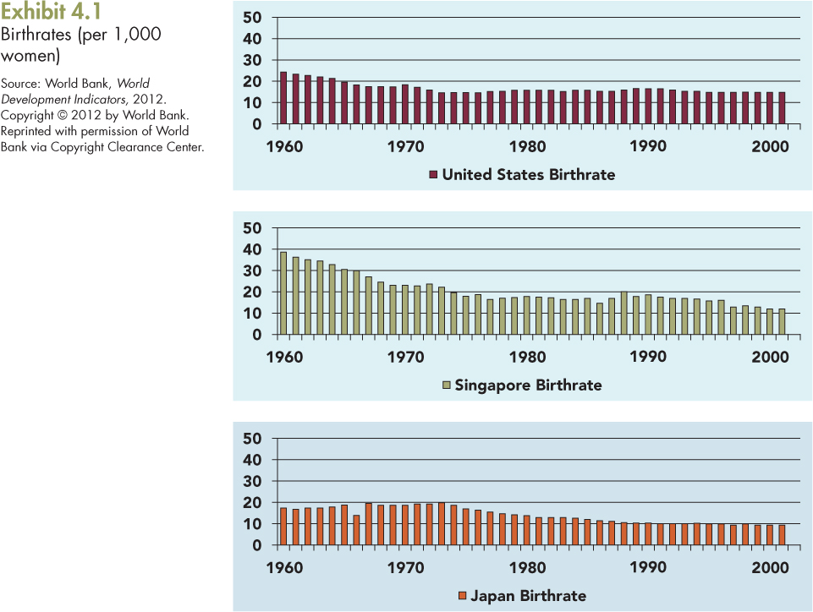
4-4

Slide 5
Culture’s Pervasive Impact
Consumption of different types of food influences culture
  Chocolate by Swiss, seafood by Japanese preference, beef by British, wines by France and Italy
Even diseases are influenced by culture
  stomach cancer in Japan, and lung cancer in Spain
Notes:
Different types of food are consumed in different cultures (Exhibit 4.2). In hot, tropical countries, spicy food is eaten as spices preserve the food even without refrigeration. The geography of the country also shapes food habits, the Japanese eat a lot of fish and seafood since that is the primary source of food for a country made up of tiny islands in the pacific ocean. The French are famous for wines and champagne because the weather and soil are conducive for grape farming. Diseases also follow food habits such as lung cancer in Spain due to excessive smoking, liver disease in Germany due to consumption of fatty foods (Exhibit 4.3).

Slide 6
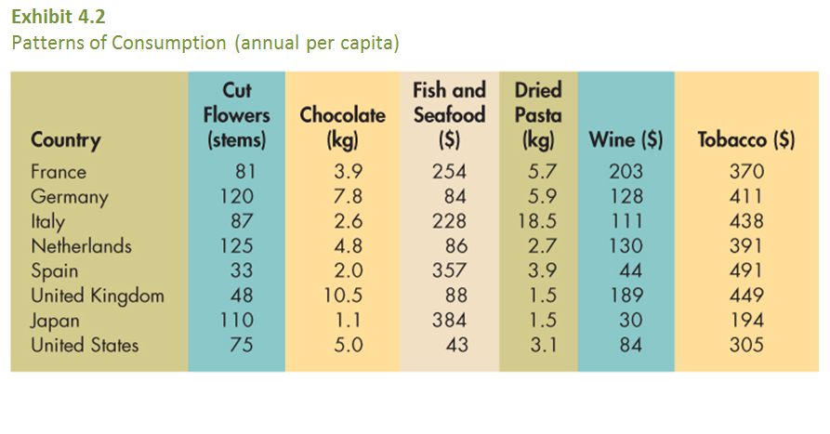
Exhibit 4.2 Patterns of Consumption (annual per capita) Source: EuroMonitor International, 2010, 2012
4-6

Slide 7
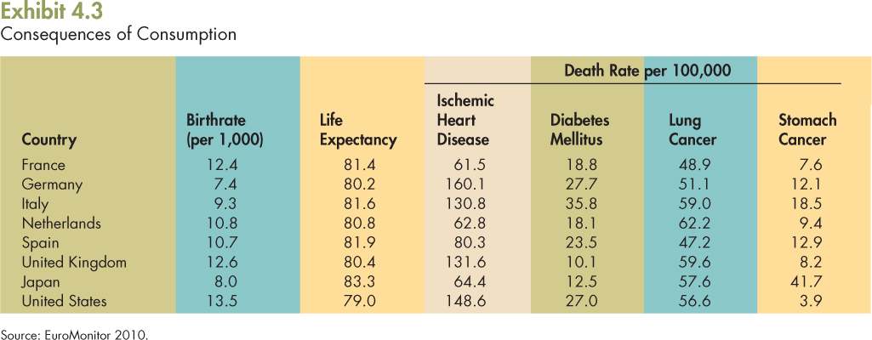
4-7

Slide 8
Three Definitions of Culture
Culture is the sum of the “values, rituals, symbols, beliefs, and thought processes that are learned, shared by a group of people, and transmitted from generation to generation”
“software of the mind, problem-solving tool” (Hofstede)
“An invisible barrier… a completely different way of organizing life, of thinking, and of conceiving the underlying assumptions about the family and the state, the economic system, and even Man himself” (Hall)

Slide 9
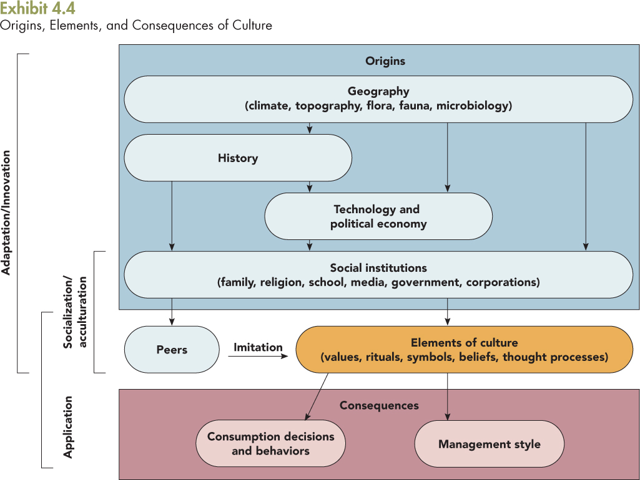
4-9
Notes:
We as humans and consumers are able to adapt to changing environments through innovation. Individuals can learn culture from social institutions through socialization (where one is raised and how) and acculturation (adjusting to a new culture). We also learn and adapt to a culture through role modeling, or imitation of peers. People also make decisions about consumption and production through application of their cultural-based knowledge.

Slide 10
Origins of Culture: Geography
Geography, which includes climate, topography, flora, fauna, and microbiology, influences our social institutions
Jared Diamond states that historically innovations spread faster east-to-west than north-to-south
Philip Parker reports strong correlations between the latitude (climate) and the per capita GDP of countries
Notes:
Geography includes more than just the weather and temperature, it is also what kind of plants and animals can be raised in the region and that influences society and consumption. According to Diamond, innovations spread faster from east to west. Before the advent of transoceanic shipping, ideas flowed over the Silk Road but not across the Sahara or the Isthmus of Panama. Parket advocates for a strong correlation between latitude and GDP, for example the GDP of Scandinavian countries are much higher than South American countries.

Slide 11
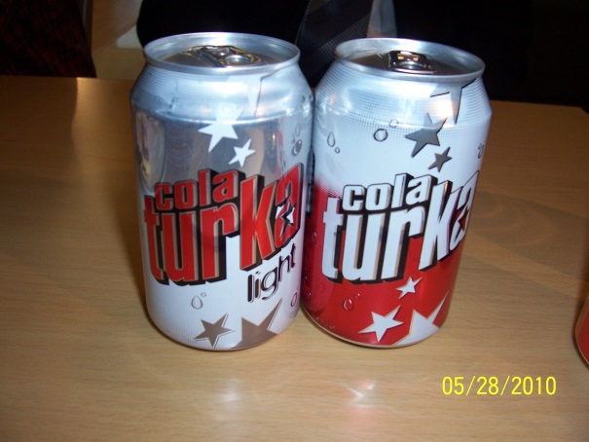
Origins of Culture: History
The impact of specific events in history can be seen reflected in technology, social institutions, cultural values, and even consumer behavior
The military conflicts in the Middle East in 2003 bred new cola brands, Mecca Cola, Muslim Up, and Arab Cola
Notes:
See the cola pictures, Turkey has their own cola called “Cola Turkey,” a coca cola taste alike, but a local brand. Military conflicts in the Middle East bred these brands, because of an anti U.S. sentiment.

Slide 12
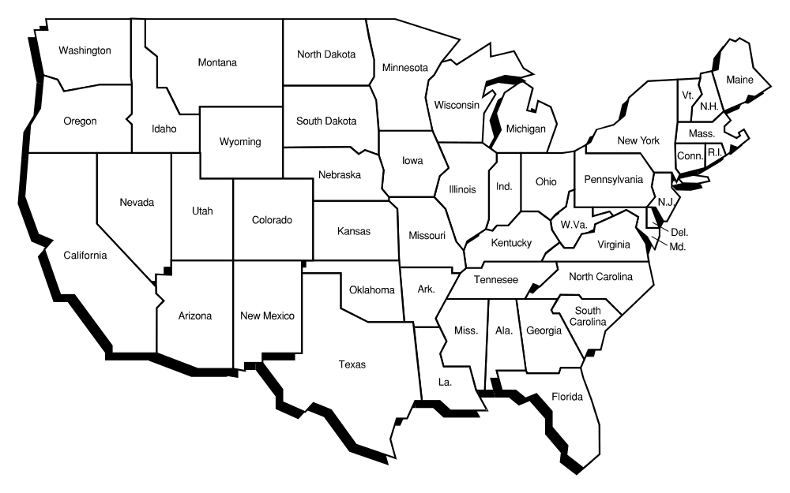
Origins of Culture: History
For e.g., American trade policy depended on tobacco being the original source of the Virginia colony’s economic survival in the 1600s
Notes:
Diamond’s book is filled with examples. For instance, America’s trade policy and its dependence on tobacco trade and its impact on Virginia's economy.

Slide 13
Origins of Culture:
The Political Economy
For most of the 20th Century three approaches to governance competed for world dominance:
  Fascism
    Fascism fell in 1945
  Communism
    Communism crumbled in the 1990s
  Democracy/free enterprise

Slide 14

Origins of Culture: Technology
Technological innovations influence cultural values
Jet aircraft, air conditioning, televisions, computers, and the internet have all influenced culture
Notes:
Every technological innovation has a profound impact on culture. For example, as we have moved from VHS tapes to DVDs to BluRay it has impacted our lifestyle, taking up less space and providing more convenience. The internet has changed the way we communicate and has made the world a smaller place.

Slide 15
Family
Behaviors
Religious
Value
Systems
School
&
Education
Social
Institutions
Government
Policies
Media
Corporations
4-15
Notes:
Social institutions including family, religion, school, the media, government, and corporations all culture, society and behavior.

Slide 16
Origins of Culture: Social Institutions
Social institutions including family, religion, school, the media, government, and corporations all affect culture
The family, social classes, group behavior, age groups, and how societies define decency and civility are interpreted differently within every culture

Slide 17
Origins of Culture: Social Institutions
Family behavior varies across the world, e.g., extended families living together to Dad washing dishes
Religious value systems differ across the world, e.g., Muslims not allowed to eat pork to Hindus not allowed to consume beef
School and education, and literacy rates affect culture and economic growth

Slide 18
Origins of Culture: Social Institutions
Media (magazines, TV, the Internet) influences culture and behavior
Government policies influence the thinking and behaviors citizens of adult citizens, e.g., the French government offers new “birth bonuses” of $800 given to women as an incentive to increase family size
Corporations influence culture via the products they market, e.g., MTV

Slide 19
Cultural
Values
Thought
Processes
Rituals
Elements
of
Culture
Beliefs
Symbols
4-19
Notes:
Underlying the cultural diversity that exists among countries are fundamental differences in cultural values , that is, the importance of things and ideas. The most useful information on how cultural values influence various types of business and market behavior comes
from the work of Dutch researcher Geert Hofstede.

Slide 20
Cultural Values
Hofstede, who studied over 90,000 people in 66 countries, found that the cultures differed along four primary dimensions
  Individualism/Collective Index (IDV), which focuses on self-orientation
  Power Distance Index (PDI), which focuses on authority orientation
  Uncertainty Avoidance Index (UAI), which focuses on risk orientation; and
  Masculinity/Femininity Index (MAS), which focuses on assertiveness and achievement
Notes:
The four 4 dimensions of culture proposed by Hofstede are described briefly above and in the following slides. Because MAS has proven least useful, our text does not consider it further.

Slide 21
Individualism/Collectivism Index
The Individualism/Collective Index refers to the preference for behavior that promotes one’s self-interest
High IDV cultures reflect an “I” mentality and tend to reward and accept individual initiative
Low IDV cultures reflect a “we” mentality and generally subjugate the individual to the group
Collectivism pertains to societies in which people from birth onward are integrated into strong, cohesive groups, which protect them in exchange for unquestioning loyalty
Notes:
Group culture is more valued in collectivistic countries: Japan, China and other Confucian cultures are more collectivistic.

Slide 22
Power Distance Index
The Power Distance Index measures power inequality between superiors and subordinates within a social system
Cultures with high PDI scores tend to be hierarchical and value power and social status
High PDI cultures the those who hold power are entitled to privileges
Cultures with low PDI scores value equality and reflect egalitarian views
Notes:
Power distance represents the extent of hierarchy in a society. Countries that are high in Power Distance such as those in Latin America or Africa, are cultures that have clear distinctions between superiors and subordinates and understand and accept that power rests with superiors.

Slide 23
Uncertainty Avoidance Index
The Uncertainty Avoidance Index measures the tolerance of uncertainty and ambiguity among members of a society
High UAI cultures are highly intolerant of ambiguity, experience anxiety and stress, accord a high level of authority to rules as a means of avoiding risk
Low UAI cultures are associated with a low level of anxiety and stress, a tolerance of deviance and dissent, and a willingness to take risks
Notes:
Countries with high UAI distrust others and rely upon people with power for information and rules and regulations to reduce risk. For example UAI countries tend to have many forms to complete and additional steps to conduct business.

Slide 24
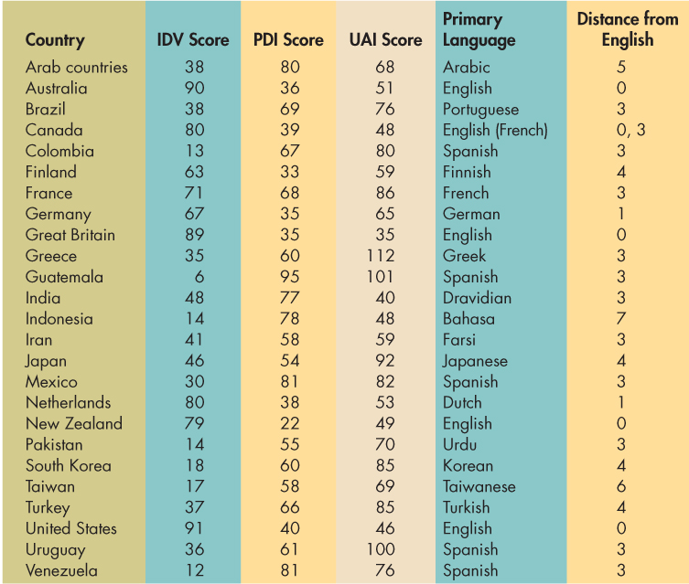
Exhibit 4.7 Hofstede's Indexes, Language, and Linguistic Distance Source: Geert Hofstede, Culture's Consequences (thousand Oaks CA: Sage, 2011).
4-24

Slide 25
Rituals and Symbols
Rituals are patterns of behavior and interaction that are learned and repeated vary from country to country
  e.g., extended lunch hours in Spain and Greece
Language as Symbols: the “languages” of time, space, things, friendships, and agreements
Notes:
Rituals are important in every culture. How Easter is celebrated in the U.S. with the Easter Bunny’s visit and a traditional meal, is very different from how it is celebrated in Mexico, where it is tradition to visit the tombstones and pay homage to the dead. Wedding gowns are typically white in the West, but very colorful and bright in the country of India where the groom arrives on a horse with an entourage (refer to the movie Monsoon Wedding mentioned in the text). Symbols in a culture include language, both verbal and non-verbal and includes the perception of time, space and relationships.

Slide 26
Rituals and Symbols
In Canada, language has been the focus of political disputes
Differences in language vocabulary varies widely, even English is different in different countries
Aesthetics as Symbols
  the arts, folklore, music, drama, and dance of a culture influences marketing
Notes:
In Canada, French versus English has been a point of contention between regions. Aesthetics includes a country’s music, art, folklore and drama.

Slide 27
Whose English?
United States
Trunk
Hood
Convertible Top
Elevator
Toilet
Bathroom
Vacuum
United Kingdom
Boot
Bonnet
Hood
Lift
W.C.
Tub or Shower
Hoover
4-27

Slide 28
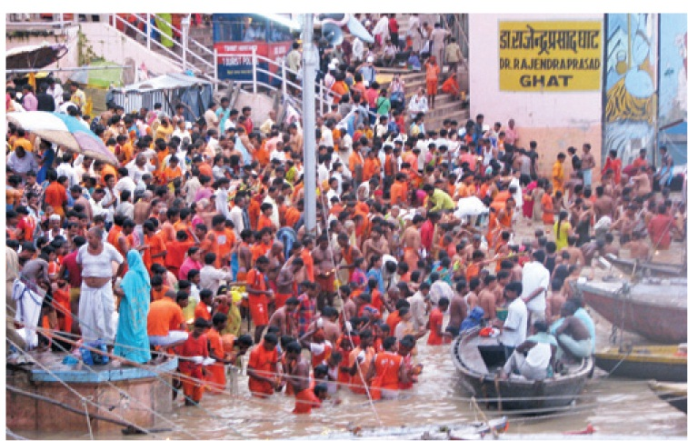
4-28
Notes:
Photo caption:
Dressed in the ritual color of saffron (orange), thousands of pilgrims of the Lord Shiva descend one of the over 100 Ghats in Varanasi, India, to perform puja (ritual cleansing of the soul). Varanasi (also known as Benares or Banaris) is one of the oldest and holiest cities in India. It is believed to be the home of Lord Shiva Hindu god) and the location of the first sermon by Buddha, so followers of numerous religions flock to Varanasi on a daily basis. Each day at sunrise and sunset, pilgrims crowd the Ghats (steps to the holy river/Mother Ganga/the River Ganges) to immerse themselves in the water and perform puja . On the busiest day of the ritual, some 5–10 million participate (according to Professor Rika Houston). Meanwhile, televised rituals such as the Academy Awards and World Cup soccer draw billions in the form of virtual crowds.

Slide 29
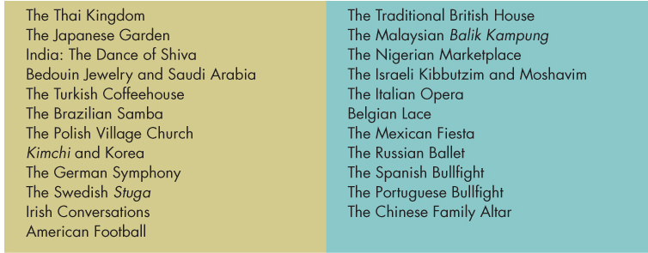
Exhibit 4.8 Metaphorical Journeys through 23 Nations
Source: Martin J. Gannon, Understanding global Cultures, Metaphorical Journeys through 23 Nations, 2nd ed. Copright 2001.
4-29

Slide 30
Beliefs
Beliefs, which mainly stem from religious training, vary from culture to culture
  The western aversion to the number 13 or refusing to walk under a ladder
  Japanese concern about Year of the Fire Horse
  The Chinese practice of Feng Shui in designing buildings
Notes:
In Asian countries such as Japan and China the number 4 represents death and it is avoided at all costs, some building even skip the fourth floor and go from 3 to 5. Similar to the superstition about the number 13 in the West. Other examples of beliefs/superstitions are: not opening an umbrella in the house (Western) or not passing salt directly to a person (Eastern).

Slide 31
Thought Processes
Thought processes also vary across cultures
  “Asian and Western” thinking
  Other examples?
Notes:
Nisbett in his book discusses differences between Asian and Western thinking. Asians (although grouping all Asian countries into one category is not generally preferred) tend to see the big picture and have a more long-term orientaion. When compared to people in the West (North America and Europe).

Slide 32
Cultural Sensitivity and Tolerance
Successful foreign marketing begins with cultural sensitivity —being familiar with nuances
A new culture can be viewed objectively, evaluated, and appreciated.
Notes:
Cultural sensitivity, or cultural empathy, must be carefully cultivated. For every amusing, annoying, peculiar, or repulsive cultural trait we find in a country, others see a similarly amusing, annoying, or repulsive trait in our culture. For example, we bathe, perfume, and deodorize our bodies in a daily ritual that is seen in many cultures as compulsive, while we often become annoyed with those cultures less concerned with natural body odor. Just because a culture is different does not make it wrong.

Slide 33
Cultural Sensitivity Has to Be Cultivated
Cultural sensitivity can be developed by acquiring knowledge about a culture including:
  Different meanings of colors, and different tastes
  General facts about a culture
It can also be developed by learning the more in-depth meaning of cultural facts:
  The meaning of time, and attitudes toward people
  Developing a degree of insight

Slide 34
Resistance to Change
Although some cultures embrace change others are resistant to it
  Working women in masculine societies like Saudi Arabia
  Lack of acceptance of GM foods (or “Frankenfood”) in Europe
Notes:
Typically everyone is resistant to change, some are more resistant than others. For example, western companies have tried to change the habit of Indians of eating warm breakfasts. However, in India, people still continue to do things like using warm milk in their cereal to have a “warm” breakfast instead of having cold cereal.

Slide 35
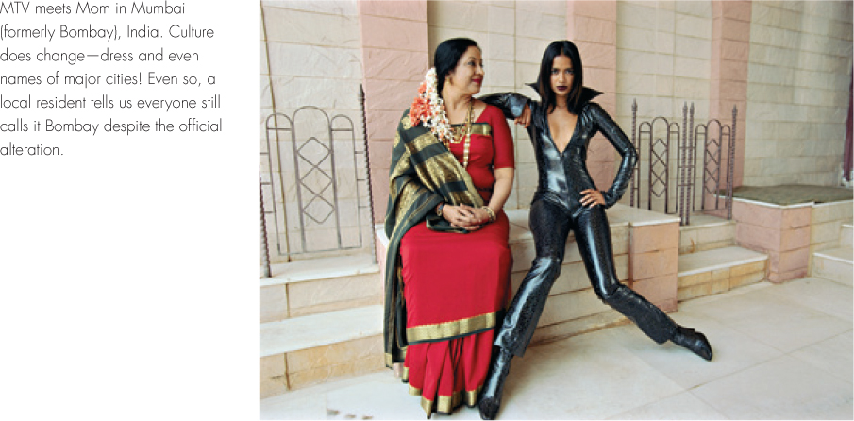
4-35

