Slide 1
EPIC VIRTUAL FIELD TRIP OF DOHA AND QATAR
by Mark Leonard Lavin and Peter Robertson
Giddy up………..

Slide 2
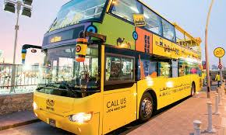

Slide 3
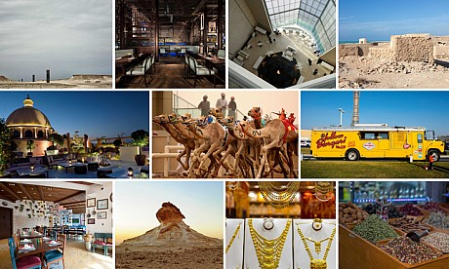

Slide 4
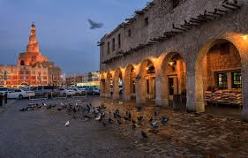
Souk Waqif
1.Souk Waqif

Slide 5
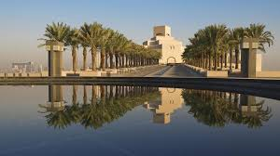
2. Museum Of Islamic Arts - MIA

Slide 6
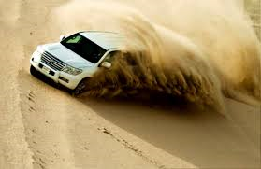
3.Dune Bashing

Slide 7
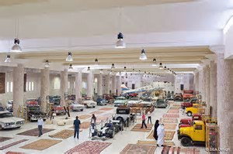
4. Sheikh Faisal Museum

Slide 8
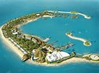
5. Banana Island

Slide 9
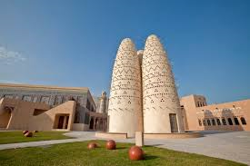
6. Katara

Slide 10
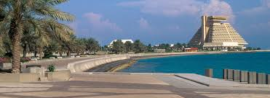
7. The Corniche
Corniche

Slide 11
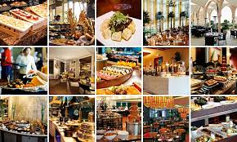
8. BRUNCH

